Slide 1


Nottingham and Nottinghamshire
Mental Wellness COVID-19 Rapid Assessment
A Population Health Management and Inequalities
approach to Mental Wellness
COVID-19
“The most beautiful people we have known are those who have known defeat, known suffering, known struggle, known loss, and have found their way out of the depths. These persons have an appreciation, a sensitivity, and an understanding of life that fills them with compassion, gentleness, and a deep loving concern. Beautiful people do not just happen.”
Elisabeth Kübler-Ross

Slide 2



Foreword
The concept that people with severe and enduring mental illness are at greater risk of poor physical health and reduced life expectancy sadly isn’t new, but when we take this knowledge and overlay the emerging evidence that shows that these existing health inequalities are also linked to a greater severity of symptoms for those contracting COVID-19. Well you can see why we’re concerned!
COVID-19 continues to pose the greatest risk for our older population, however it would be wrong to say that “underlying health conditions” are solely age related, therefore working in partnership across our system utilising expertise from external organisations such as Nottingham Trent University, Experian and Imperial College London we were able to produce this rapid assessment to look at what we can do quickly to support those with a mental health condition to cope during and after COVID-19. Our assessment has identified seven impactable interventions/topics that could prevent escalation of a mental health episode. The aim being to collectively use our resources, skills and expertise to support our population through one of the most trying times.
Our approach will be fluid as we learn more about COVID-19, therefore this rapid assessment will form part of the wider Mental Wellness review due to presented to the ICS board in September 2020.
Dr Andy Haynes
ICS Executive Lead
Amanda Sullivan
Accountable Officer
NHS Nottingham and Nottinghamshire CCG
Dr John Brewin
Chief Executive Nottinghamshire Healthcare Foundation Trust

Slide 3

Executive Summary
Although the initial response to COVID-19, was that of a health crisis, it is becoming more apparent that this pandemic has sown the seeds for what could be a significant mental health crisis for our community. Our citizens are anxious due to the risk off catching the infection, dying or losing family members.
Emotional difficulties among children and adolescents are exacerbated by family stress, social isolation, with some facing increased abuse, disrupted education. With many at risk of losing their income and livelihoods it’s easy to see why our population is feeling scared.
Rapid implementation of these recommended actions will be essential to ensure our communities are better protected from the mental health impact of COVID-19. Our rapid
assessment has identified specific population
groups who are experiencing a significant impact;
therefore our initial focus should be on those:-
Who are shielded/Isolated/vulnerable
Experiencing Financial Challenges/Unempl-
oyment
Families losing their support Infrastructure
Who have suffered a bereavement
BAME Groups
Who have multiple Long Term Conditions(LTC)
Frontline Workforce/Key workers
This document has identified interventions for the above cohorts to minimize the mental health consequences of the pandemic, the following is an executive summary of
those interventions:-
Ensure wide spread availability of mental health and psychosocial support – Commission mental health interventions that can be delivered remotely, for example tele-counselling for frontline health-care workers and people at home with depression and anxiety;
Prepare for an increase in activity - Local services should prepare for an increase in mental health cases in the population during a state of emergency. Plausible estimates of the increase in incidence of mental ill health in previous crises range from 5% - 20%. However, amongst the general population, this increase is expected to subside once the response/quarantine measures are lifted.
Clear Communication - Say it loud, say it clear. Where information is shared, it should be clear, timely and in a language that meets the communities needs to reduce uncertainty. This should include a time period up to 6—12 months after the “peak” to mitigate any confusion or discrimination/tensions that could arise. Information, should be consistent and where necessary targeted to support communities and groups where stigma could remain.
Responding to COVID-19 as a community - Most needs can be met through routine services, including informal or non statutory services, however in order to mitigate a potential increase in demand the system should consider other methods for providing less intense mental health care within communities, using natural community assets and groups such as NHS website, volunteer groups charities and workplace support as resources to give the system additional capacity to bridge a gap and enable stepping stones to other services. Employers have an important role in proactively identifying at risk individuals and providing appropriate support to all employees
Seldom heard, easy to ignore - Seldom heard groups will require tailored communications and where necessary existing charities and volunteer groups/religious organisations are best placed to offer this additional support. Making Every Contact Count (MECC) approach should be incorporated in all services from universal to specialist, plus informal services where possible.
Mutual aid should be supported to increase a sense of belonging and reduce loneliness. Other population level interventions may be effective but have limited evidence. Local systems should note the challenges around seldom heard and deprived groups. Online assessments should not be supported for high risk patients as important cues could be missed. A trauma-informed approach in all services is recommended and it is imperative to ensure mental health staff are supported with training to deliver interventions in new ways
Promote Self Care and Community/Individual Empowerment - This should be the first point of intervention for the general population. Promotion of physical and mental wellbeing is critical to good outcomes for our population. Making good use of community and family networks is widely recommended with distraction and creative resources particularly helpful, especially for families with children. Utilisation of existing charities websites and intelligence will mitigate the need to create new material, and contradict national advice/guidance. Consideration of accessibility, alternative formats is important and should be noted, particularly for individuals/families who are technologically deprived.
Opportunist screening – Look for opportunities to implement early intervention to prevent escalation of crises. Targeted support should be offered in a format that meets the needs of this cohort. All written formats should be easy to read, accessible and shared from a trusted source.

Slide 4
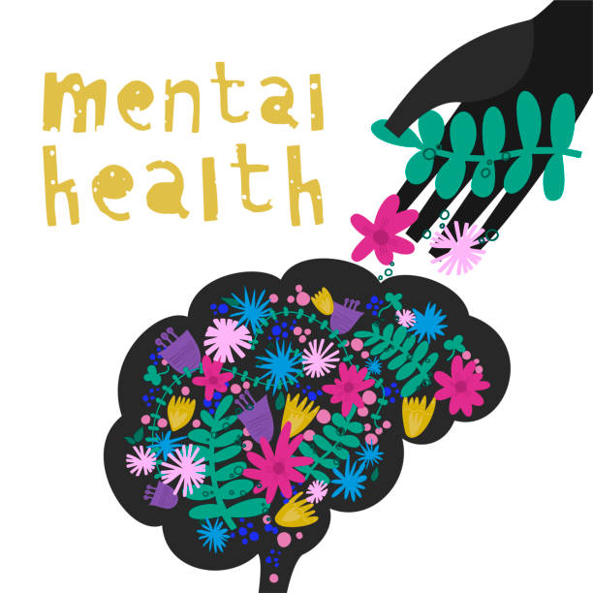
Introduction
Mental health problems are a growing public health concern both globally and locally.
Globally a recent index of 301 diseases found mental health problems to be one of the main causes of the overall disease burden worldwide. According to the 2013 Global Burden of Disease study, the predominant mental health problem worldwide is depression, followed by anxiety, schizophrenia and bipolar disorder. In 2013, depression was the second leading cause of years lived with disability worldwide, behind lower back pain. In 26 countries, depression was the primary driver of disability. Depressive disorders also contribute to the burden of suicide and heart disease on mortality and disability; they have both a direct and an indirect impact on the length and quality of life.
The World Health Organization (WHO) estimates that between 35% and 50% of people with severe mental health problems in developed countries, and 76 – 85% in developing countries, receive no treatment.
Good mental health and well-being is fundamental to living our best life and to the lives of the communities in which we live. It drives everything we do, how we think, how we behave and more importantly how we feel and act. As a diverse population we are all susceptible to mental health problems, however the risk of experiencing mental ill-health is not equally distributed across our population. It is unfortunate that those who face the greatest disadvantages in life also face the greatest risk to their mental health.
Mental health is the second highest cause of disability and illness. Globally and in Nottingham/ Nottinghamshire, 14% or 1 in 7 of quality life years lost to disability or illness can be attributed to mental illness.
We know that in our community we already have a significant prevalence of MH conditions and this is aligned to our areas of deprivation.
Since the COVID-19 pandemic and the associated measures that have been introduced i.e. lockdown, social distancing etc., the longer-term socioeconomic impacts are highly likely to intensify the inequalities that contribute towards the increased prevalence and unequal distribution of mental ill-health across our system.
This document is a rapid assessment of the impact of COVID-19 on an already struggling cohort of our population, it will describe high level interventions that could be undertaken quickly to ease some of these difficult times.
Background
The LRF Data and information Cell was tasked to carry out a rapid assessment on the mental wellness of our population during this pandemic. Fundamentally we know that mental health is shaped by three sets of circumstances:-
1. Our genetic make up and the way they are expressed.
2. The Environment/Social circumstances we find ourselves in. (This includes violence, poverty and employment).
3. The personal experiences that defines us (our family, and circumstances and how we view ourselves
The conditions in which we are born, and subsequently live are more likely to have an impact on our mental wellness. Populations who live within the lowest socio economic groups have the worst mental health, therefore its important to understand what that social gradient looks like within Nottingham and Nottinghamshire as this will play an integral part on the impact the pandemic will have on our population.

Slide 5
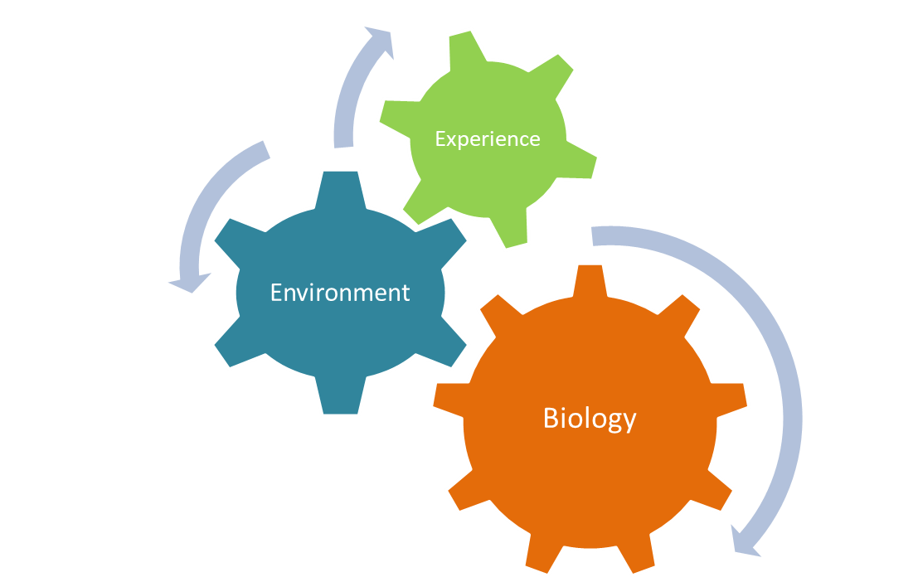
Scope
Mental wellness is shaped not only by our genetics, but also the world around us and our life experiences. The COVID-19 pandemic will almost inevitably have an impact on our wellness!
MH Triggers (attributed to COVID-19)
Personal post-infection (home, hospital, ITU) rehabilitation
Impact on reduced ability to access physical healthcare needs
Post traumatic stress disorder
Bereavement, including complex grief
Vulnerable groups – BAME, children and young people, over 70s
Domestic abuse
Safeguarding issues
Emotional and mental health needs i.e.. anxiety and depression, deliberate self harm and self injury
Substance use and other addiction problems i.e.. gambling
Rough sleeping
Consequences of economic effects on individual and families (jobs housing family breakdown)
When looking at the impact COVID-19 has had on our population it is as important to include the social demographic factors such as employment, education, poverty, family and crime, alongside the health attributes, generic factors that may/may not be possible to influence. The link between poverty and mental health isn’t new, however pulling them together to characterise our cohort.
With this in mind a scoping meeting was held to plan this rapid assessment in which the following scope was agreed:-

Slide 6
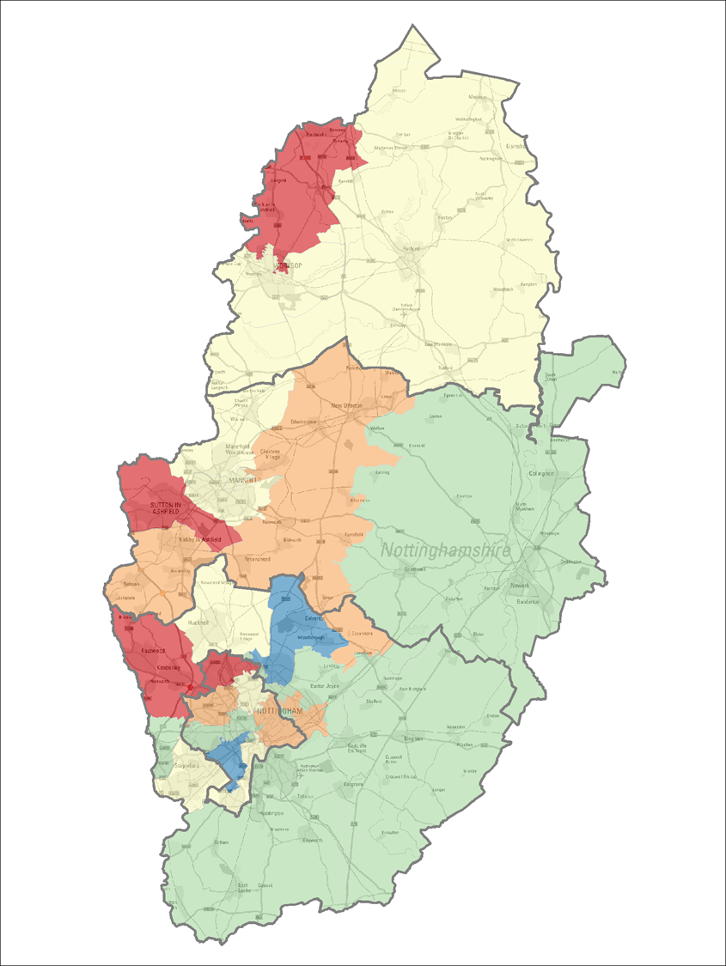
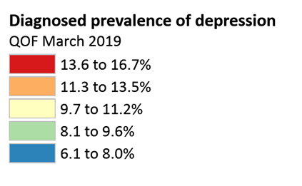
Prevalence of Mental Health Problems
The causes and influences of mental health problems are wide ranging and are often associated with adverse events in our lives and other circumstances, such as poverty, unemployment, levels of supportive networks, levels of education and the broader social environment. These factors interact and affect how resilient we are in coping with these challenges.
Mental health is one of the main causes of the overallburden.¹
Mental health and behavioural problems(e.g. depression, anxiety and drug use) are reported be the primary drivers of disability world wide, over 40 million years disability in 20 to-year-olds.²
Major depression is thought to be the second leading cause worldwide and a major contributor to the burden of suicide and ischemic heart disease.³
It is estimated that1 in 6in the past week experienced a common mental health problem⁴
Good mental health is linked to good physical health and social factors, therefore it is unsurprising to see that poor mental health and inequalities go hand in hand.
Mental health disorders account for almost a quarter of the total burden of ill health within the UK with an increased burden of mental health disorders following a disaster. Therefore there is no doubt that the COVID-19 pandemic will have a significant impact on our populations wellbeing. This increased exposure to stressors and a decrease in support mechanisms will see an increase in demand of around 5-20% during the peak. Within our community mental health and deprivation are strongly linked, therefore to tackle and support mental health, this needs to be done hand in hand with tackling inequalities adopting a population approach. The map below demonstrates the diagnosed prevalence of depression within Nottingham and Nottinghamshire and where initial focus/prioritisation needs to be undertaken.
Patients on the SMI register represents 1% of the Nottingham/Nottinghamshire population and the England percentage 0.9% for the (latest available) period April 2016 to March 2017.
Diagnosed prevalence of depression
*Active patients (not deceased and not moved away) registers maintained within GPRCC including:
Mental Health Psychosis, Schizophrenia and Bipolar based on the same GP read codes used for the SMI (Severe Mental Illness), NHS England Quality and Outcomes Framework.
Depression using the GP Register for Depression which includes codes as determined by NHS England Quality and Outcomes Framework.

Slide 7
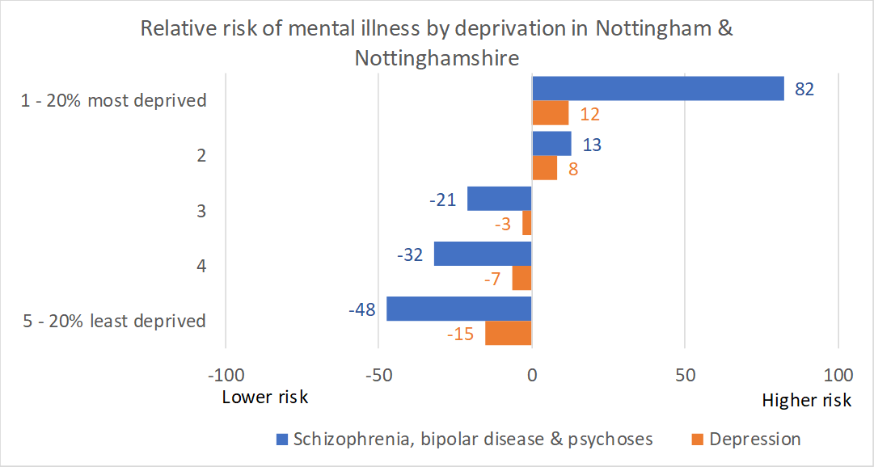
Prevalence of Mental Health Problems - Continued
People who live in parts of Nottingham City or Nottinghamshire that are the fifth most deprived in England are 82% more likely to have a diagnosis of schizophrenia, bipolar disease or other psychosis, compared to the County / City population as a whole.
The risk is halved (48% lower) for people who live in areas that are in the fifth least deprived.
The social gradient is not as steep for depression but people living in the most deprived areas are 12% more likely to be diagnosed with depression; people living in the least deprived areas are 15% less likely to have a diagnosis of depression.
*Risks are crude & not adjusted for factors other than deprivation.
*Active patients (not deceased and not moved away) registers maintained within GPRCC including:
Mental Health Psychosis, Schizophrenia and Bipolar based on the same GP read codes used for the SMI (Severe Mental Illness), NHS England Quality and Outcomes Framework.
Depression using the GP Register for Depression which includes codes as determined by NHS England Quality and Outcomes Framework.

Slide 8
Prevalence of Mental Health Problems - Continued
Data source: eHealthscope
Data source: eHealthscope
Data source: eHealthscope

Slide 9

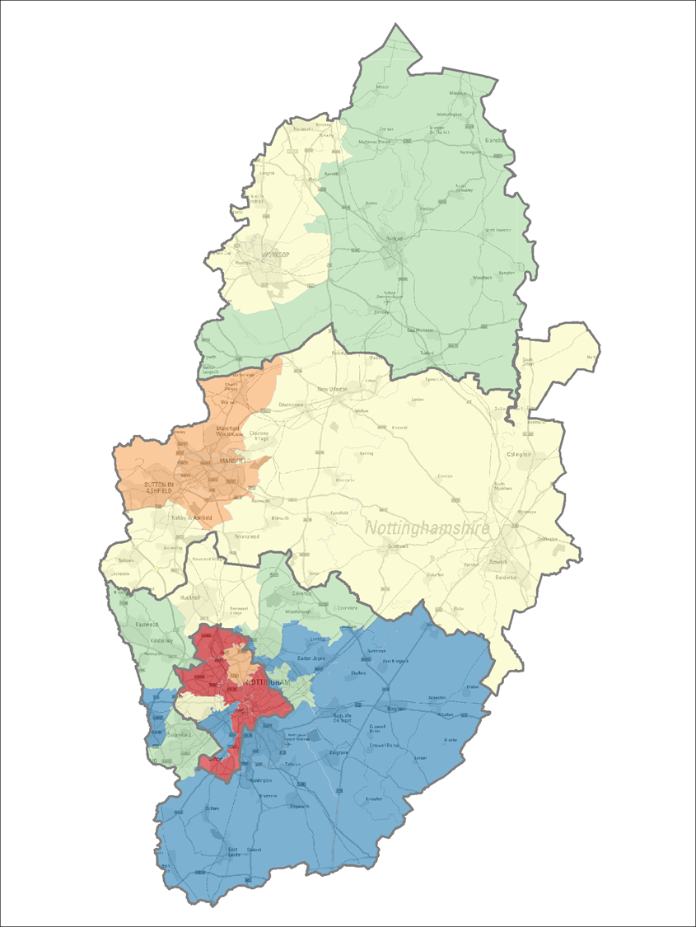

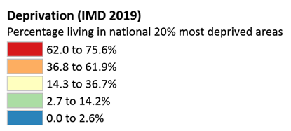
Deprivation, Mental Health and COVID-19
COVID-19 has seen a significant impact on some of the lowest paid members of society, care workers, manual labourers. The Office of National Statistics (ONS) published statistics on COVID-19 deaths broken down by local area and socioeconomic deprivation. These revealed that the age-standardised mortality rate of deaths involving COVID-19 in the most deprived areas of England was 55.1 deaths per 100,000 population, compared with 25.3 deaths per 100,000 population in the least deprived areas (see https://www.ons.gov. uk/releases/spatialanalysisondeathsregisteredinvolving COVID-19, demonstrating that people living in deprivation are bearing the brunt of the pandemic in the UK. Due to their profession those with lower income jobs were unable to work from home and therefore disproportionately affected by the virus. Self isolation has been tough, and throughout this document we will identify how we should support those who are isolated.
However staying at home in a house with outside space is significantly easier to staying at home in a small confined space with no or limited outside space. This will undoubtedly have an impact on how well an individual or family copes through the pandemic. Couple this with the knowledge that one in five in England are living in a home that puts their health, safety or wellbeing at risk further enhances the vulnerabilities for those already vulnerable.
Understanding and addressing inequalities is crucial to ensuring the response to COVID-19 is, supporting our population regardless of their job or income. The map below shows that Nottingham and Nottinghamshire has some of the highest areas of deprivation. These inequalities will need to be considered when looking at targeted interventions to reduce further impact, and improve outcomes particularly for the cohort affected with a mental health condition.
The depression register represents 15% of the Nottingham/Nottinghamshire population and the England percentage 10.7% for the (latest available) period 01 Apr 2018 to 31 Mar 2019

Slide 10
Life Expectancy and Healthy Life Expectancy – Heat Map
Data source: https://www.nottinghamshireinsight.org.uk/Libraries/Document-Library

Slide 11
Life Expectancy and Healthy Life Expectancy - by ICP and PCN
Data source: https://www.nottinghamshireinsight.org.uk/Libraries/Document-Library

Slide 12
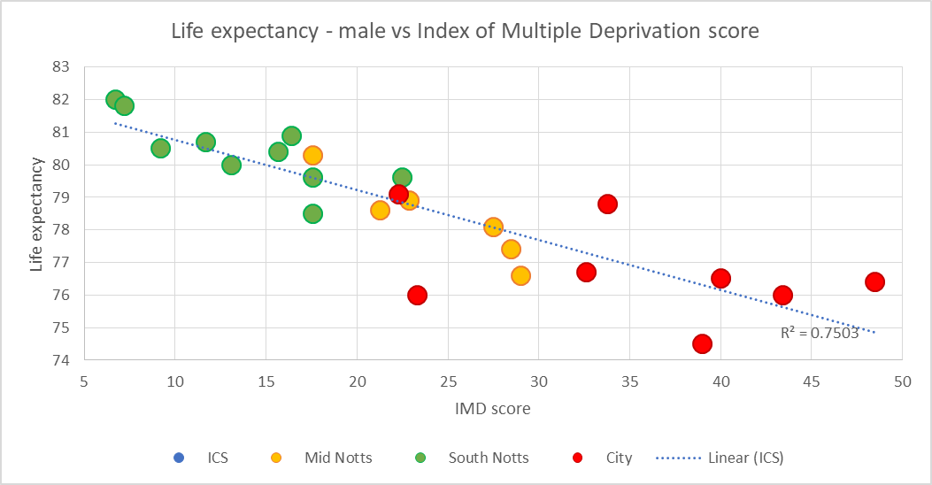
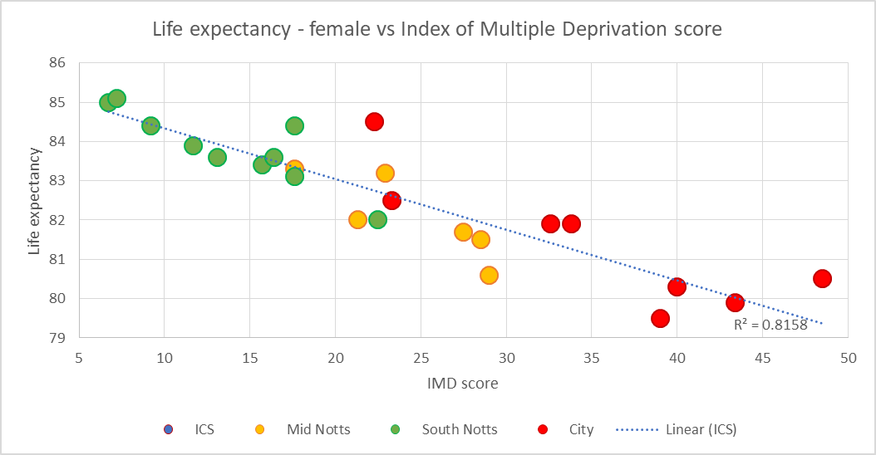
Life Expectancy vs. Deprivation – Index of Multiple Deprivation Score (IMD)
Data source: https://www.nottinghamshireinsight.org.uk/Libraries/Document-Library

Slide 13
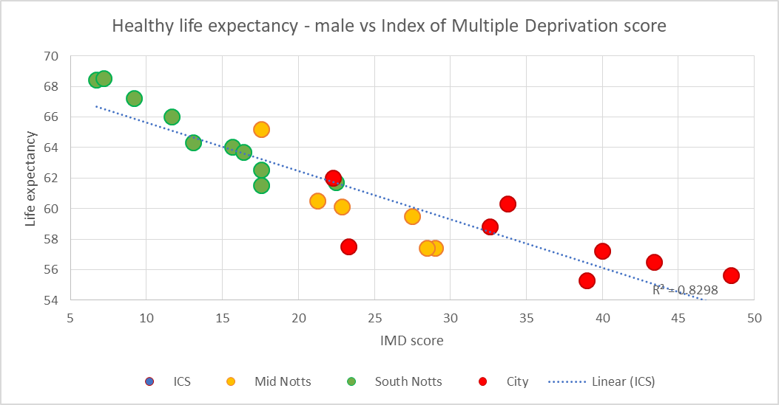
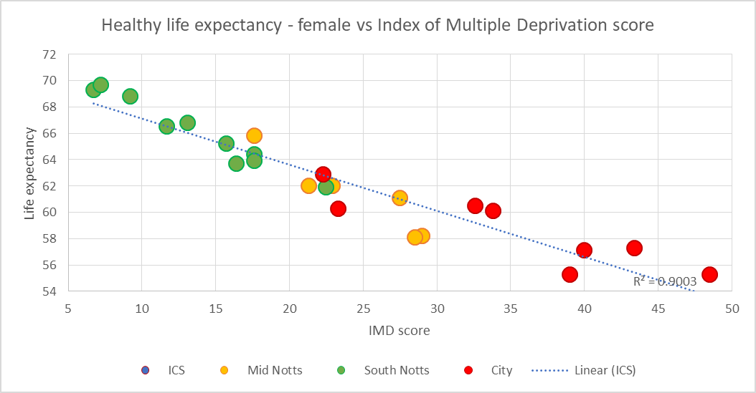
Healthy Life Expectancy vs. Deprivation (IMD)
Data source: https://www.nottinghamshireinsight.org.uk/Libraries/Document-Library

Slide 14
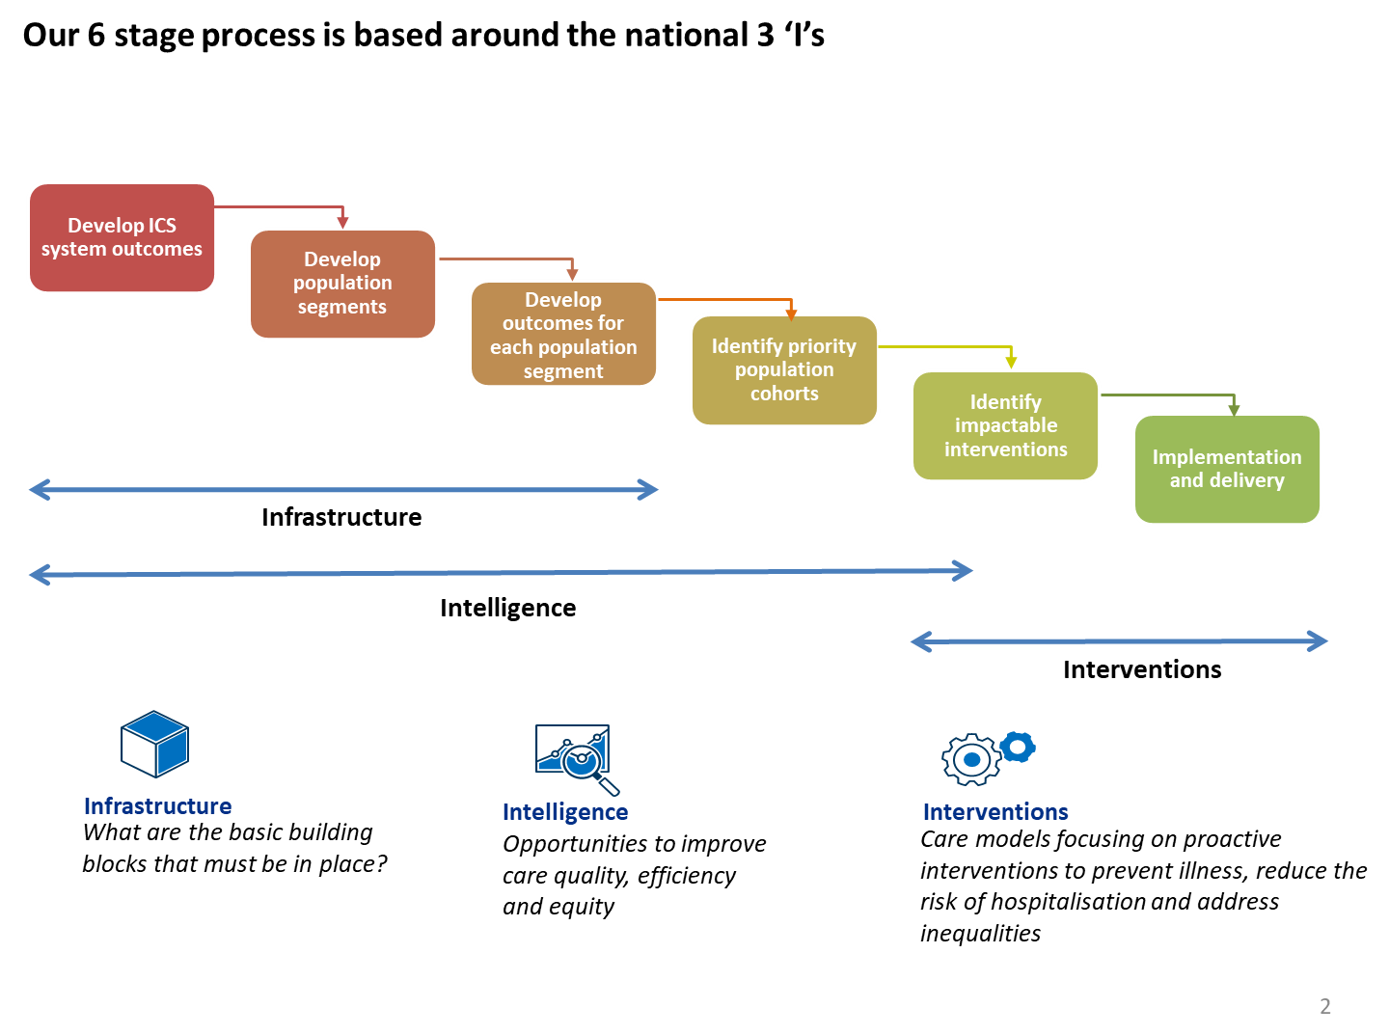
Methodology
Population Health is an approach that aims to improve physical and mental health outcomes, promote wellbeing and reduce health inequalities across an entire population. This includes focusing on the wider determinants of health – which have a significant impact as only 20% of a person’s health outcomes are attributed to the ability to access good quality health care – and the crucial role of communities and local people.
This work is a reactive approach in response to the COVID-19 pandemic. The methodology used follows a systematic Population Health Management (PHM) approach, with some steps expedited to meet the urgency of system requirements. A full review of mental wellness is currently underway and should be completed by September 2020 which will look at mental health in its entirety through a full PHM approach.
COVID-19 Rapid Response Approach

Slide 15




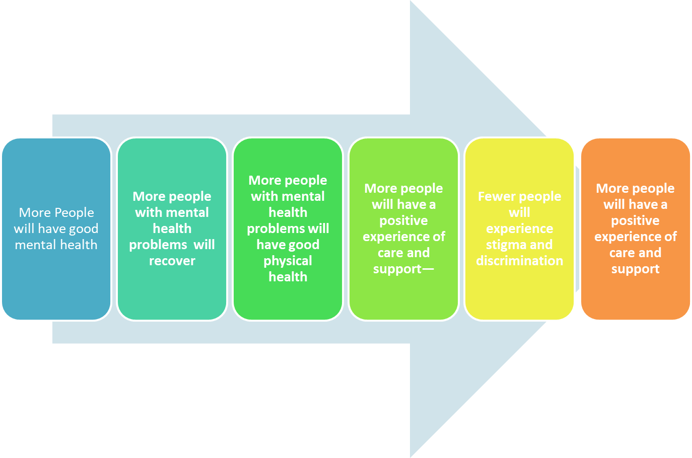
Our COVID-19 Mental Health Outcomes
The following are our high level mental health population objectives to support the populations through and after the COVID-19 pandemic. These rapidly produced objectives were obtained using clinical and research experts, feedback from community groups and national direction.
High
Intensity
Minimise potential increase in suicide rate for 2020
Increase early identification and prevent escalation of MH symptoms
Prevent increase in child poverty
Reduce number of people newly identified as homeless
Identify and continue to support shielded population who may become anxious leaving the home
Targeted/
Secondary Care
Develop resilience alongside living with mental health conditions
Supported families with home education/support
Increase in people receiving good quality financial advice and safer financial services
Prevent escalation of mental health symptoms
Reduce social isolation
Universal Contact
Maximise self-care behaviours that promote mental wellbeing and resilience
Support for families, living, working schooling at home (routine, boredom, stress)
Support for families, returning to normal
Support and guidance for those living in an “outbreak hotspot”
Supported key workers/support services
Improved financial literacy and planning
Self Care
Our System MH Objectives

Slide 16
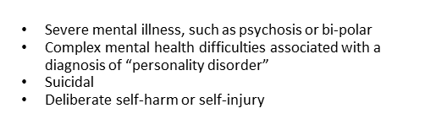
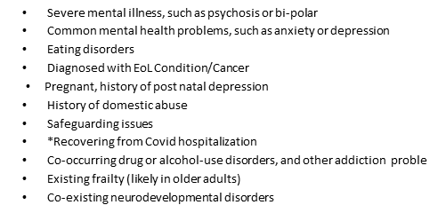
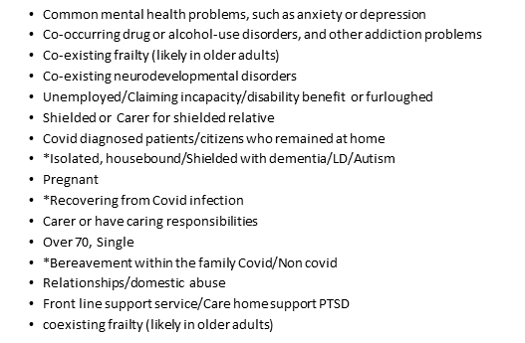
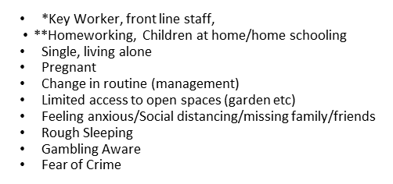
Our COVID-19 Risk Stratification Process
(defining the characteristics)
Through defining our population at each levels, identifying the populations characteristics that sits within each segment enables the data mapping process across Nottingham/Nottinghamshire. This approach enables us to understand our system wide mental health requirements both now for a rapid COVID-19 response and later to facilitate and inform strategic commissioning.
High Intensity
Targeted Contact – Secondary Care
Universal Contact – Primary Care
Self Care

Slide 17
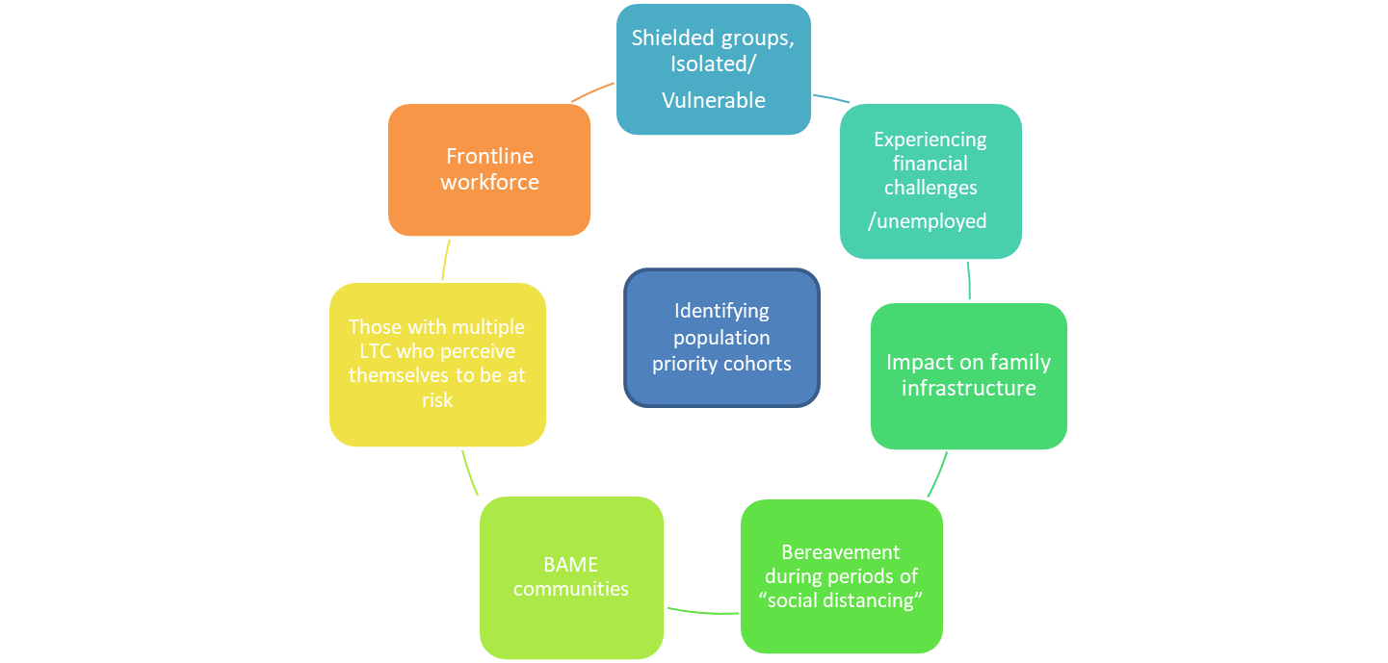
Identifying Population Priority Cohorts
The next steps was to stratify the interventions (Rapid Assessment). We know that the COVID-19 pandemic is putting a strain on an already vulnerable population and current evidence shows that Mental health services within Nottingham and Nottinghamshire should be prepared to see more cases, of greater severity, and greater illness during an emergency situation (COVID-19).
The following have been identified as the priority groups to initially focus our interventions.

Slide 18
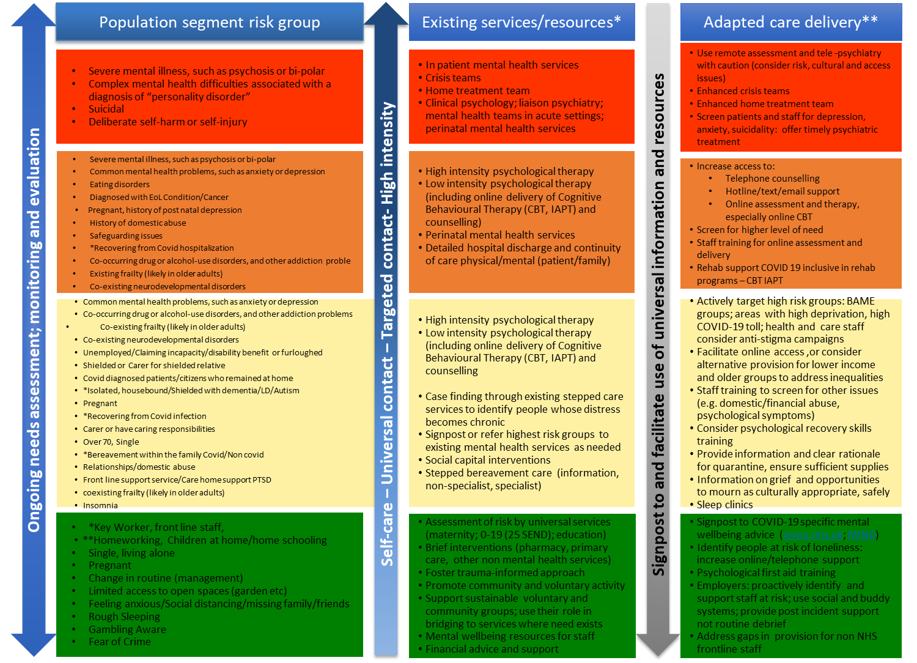
Identifying Broad Map of Interventions
Column one below shows the initial segmentation of the population to meet our COVID–19 objectives.
Column two depicts the currently available services and resources within our system to support this segment.
Column three identifies the proposed broad map of interventions and adaptations of existing services/care/resources
A rapid evidence review was carried out on interventions that could potentially mitigate the mental health effects of COVID-19 and ways to adapt care delivery for those with need for services. This was based on the population level segments. The review utilised existing literature searches, working with colleagues from our local research team and local universities.

Slide 19

Identify Impactable Interventions
“Increasing the strength of our minds is the only way to reduce the difficulty of life.”
Mokokoma Mokhonoana

Slide 20
1. Shielded/Isolated or Vulnerable
Loneliness, social isolation and vulnerability have a strong impact on our mental health. We know that COVID-19 has exacerbated feelings of loneliness by physically isolating those that bring us comfort. While these actions were necessary to save lives, it is yet unknown how these changes will impact on our population for years to come. Local data shows that over 25% of our population characterised as clinically or socially vulnerable to COVID-19 already have a diagnosis of depressions or an SMI. This cohort is therefore susceptible to their condition being amplified, not only during COVID-19, but also after. In order to mitigate any further impact, community groups, charities and voluntary sectors should be working with Local authorities, primary care networks and integrated care providers to reach out to these groups to sustain or re-establish some element of contact. To mitigate duplication this approach is best co-ordinated through groups that work at system level. The Humanitarian Advisory Group (or similar) cells have strong links with charities and volunteer groups and would be a good starting point to co-ordinate. The definition for this cohort is those who are living alone or isolated (socially vulnerable) compared to those who are Extremely Clinically Vulnerable (clinically susceptible to COVID-19).
COVID-19 risk groups (at 24 June)
- MH & LD co-morbidities
Data source: eHealthscope
High Risk – shielded: list of patients advised to shield. Joining this list is based largely on strict criteria published by NHSE/D. However a few people have been added by acute trusts and GPs on looser criteria
Moderate risk related to the initial definition of the shielded group. (include some vulnerable criteria)
Low risk related to flu-like group.
Data source: eHealthscope

Slide 21
Interventions to Support Shielded/isolated or
vulnerable population
Identify and support cohort during and after COVID-19
Ensure existing services and support networks in place to manage anxiety and stress of COVID-19 prepare for 5-20% increase
Ensure those identified as isolated, shielded, vulnerable are linked to appropriate services, community groups, voluntary services, Housing etc.
Ensure recovery information is available in alternative formats, languages, braille talking books etc..
Provide or signpost information on how to begin a safe return to normality – slow transition
Encourage developing support bubbles to manage anxieties and stress of “recovery
/normality”
Encourage cohort to keep active stressing importance of being COVID-19 safe
From 6th July encourage cohort to socialise/ meet in a group of up to 6 people outdoors, including people from different households, while maintaining strict social distancing
Begin the conversation of returning to work (if COVID-19 friendly) from 1st August. Enable support and information to prepare for this transition
Begin the conversations of returning to school
Encourage mental and emotional wellbeing/self care info such as 5 ways to wellbeing
Example | Evaluation
Ensure patients have access to the Patient Information leaflets Ensure those isolated (and not known to the system) are linked with community voluntary groups/charities. Ensure websites are a central point of information and intelligence that is available or signposted to sites for multiple languages Encourage mental and emotional wellbeing/self care information is available such as 5 ways to wellbeing | No of EVP/VP on list unknown to the system No of EVP/VP with support package No of organisations currently supporting isolated services, including support package. EVP/VP broken down by Place No accessing existing CMH services No applications for support

Slide 22
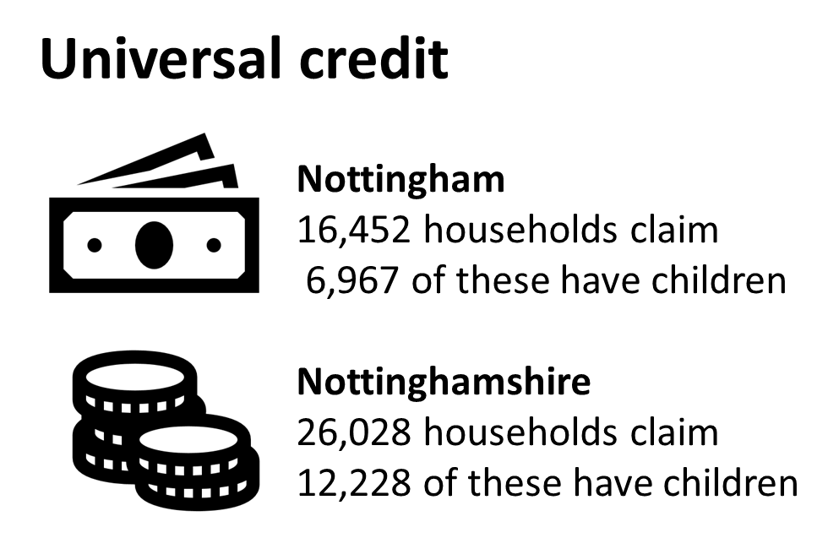
2. Experiencing financial challenges/Unemployed
Money and Mental Health Org has said that People with mental health problems are three and a half times as likely to be in problem debt: This cohort is also overrepresented in low paid, part-time and temporary employment and therefore unable to survive an income shock caused by COVID-19 such as being furloughed, having to rely on universal credit etc.
Prior to the pandemic, Nottingham and Nottinghamshire was already experiencing significant variation in financial inequalities/deprivation. COVID-19 has seen the working status of those within our population change negatively and with it bringing challenges for our families and communities. Those people who are self employed have also been significantly affected, and while furlough continues to support this cohort, it is also recognised that this support is time limited.
The more debt people have, the greater the likelihood of a mental health condition. Strong link between financial inequalities and COVID-19 has added to the mental health problem, therefore clear and targeted communications and signposting to existing support infrastructures is key at this time. Charitable organisations such as https://workingfamilies.org.uk/articles/coronavirus-support/ has a breadth of information that guides families through the challenges caused through COVID-19.
Nottingham/Nottinghamshire – 1.1m population the following has been identified:
2 In 5 who have been affected by Mental Health problems have had a drop in income due to COVID-19
34% of unemployed people experienced mental distress, compared to 16% of those in employment
28% of people who identified as unemployed reported current experience of negative mental health, compared to 13% of people in paid employment,
COVID-19 Pandemic, Financial Inequality and Mental Health, Mental Health Foundation 2020

Slide 23
2. Interventions to support those experiencing financial challenges/unemployed
Support families to meet the financial challenges COVID-19 has presented in the short and longer term
Identify proportion of population living on credit and whether this in communities has increased
Provide mental help support to manage financial stress and anxieties
Promote /signpost how to make expenditure changes, i.e.. changing energy suppliers, eating on a budget, managing credit cards etc.
Signposting people who have found themselves redundant or unemployed to community advisory services
Offer guidance/signpost on how to respond to rent/mortgage arrears
Offer support/signpost guidance on how to manage credit card debt/everyday loan risks
Monitor uptake of universal credit,
Provide clear information/sign posting on how to manage debt
Example | Evaluation
Ensure GPs, community centres and accessible locations have information, leaflets and posters informing families and individuals of where and how to access information.. For financial support and information signpost to https://workingfamilies.org.uk/ (working families) https://contact.org.uk/ (for families with disabled children) https://www.gingerbread.org.uk/ (single parents) https://www.citizensadvice.org.uk/ (universal support and advice) https://capuk.org/ (financial and debt advice for all) https://www.nottinghamcu.co.uk/ (community savings & loans) ) | Monitor uptake in universal credit Monitor uptake in food banks Monitor uptake in loans Monitor rent arrears Monitor food bank usage Monitor free school meal applications Identify % living on credit % increase in unemployed % Furloughed Above if possible broken down by BAME group
Targeted Interventions:

Slide 24
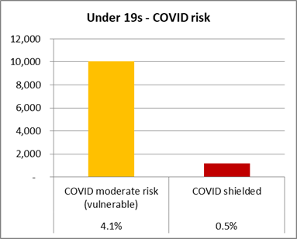
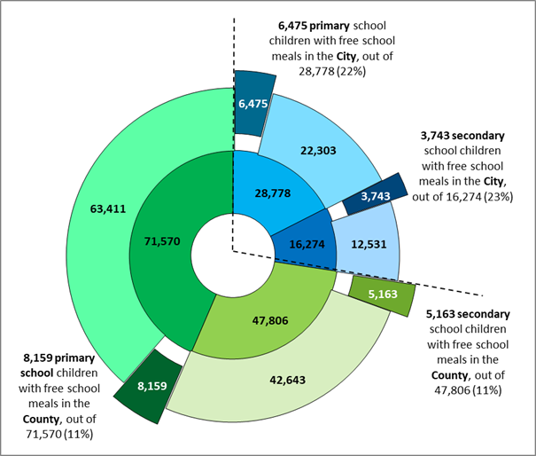
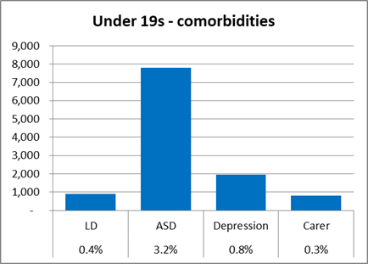
3.Families and their Infrastructure
Supporting families to recognise that they need help, and supporting them to seek help is key, particularly when a stigma in seeking help often follows. The prevalence and variation in deprivation across the population will intensify over the next few months as the system moves from emergency response to recovery. The financial situation will add to these pressures, and force a wider deprivation gap and add complexities to an already complex situation.
The closure of schools and the socially distancing of family members may result in low income families suddenly finding themselves in a position to fend for themselves, financially and emotionally. Couple this with an increase in bills (due to more time being spent at home ) will add stresses and anxieties to an already boiling pot. The immediate priority for our system is to ensure our most vulnerable families feel supported to seek help and advice where and when needed. Children's emotional state and behaviours have been affected during the pandemic. Targeted interventions for children with disabilities, children in crowded settings and known to the system as vulnerable should be our initial priority.
To enhance support at this time systems should be signposting
and guiding families to where they can receive virtual support . signposting to websites of existing charities such as Relate, NSPCC, Care For The Family and Child Mind (are a few) of the charities offering excellent online support focussed on supporting families through the socio and mental impact of COVID-19.
Where targeted support is needed, our local voluntary support groups are in the best position to reach out to our local families. This support should be light touch, non-intrusive with the aim of offering guidance, support and a friendly ear to manage through difficult times.
Understanding this cohort is paramount. Guidance on how to access universal credit and other support packages should be communicated, and families encouraged to utilise financial charities who can offer support to help them manage during this period is a critical element. Identifying those already in receipt of free school meals is a good indicator. The priority at this stage is to ensure that those vulnerable have economic stability. The system will need to proactively monitor (with the support of local charities and volunteer groups) current and future demands for food banks. Particularly among families with children. Monitoring of whether this demand is increasing is a good indicator understand the impact of COVID-19 on our families, particularly in relation to financial inequalities and wellness.
Data source: eHealthscope

Slide 25
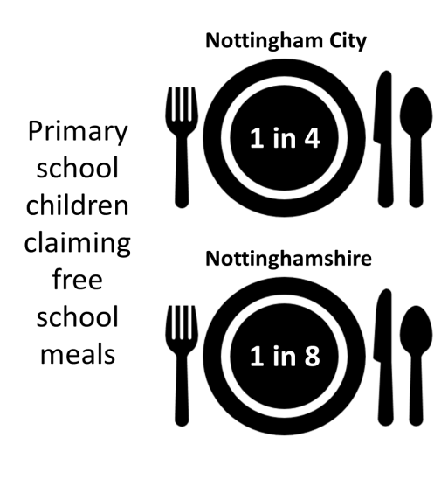
3.Families and their Infrastructure Cont….
Nottingham/Nottinghamshire – 1.1m population the following has been identified:
Primary free school meals 6475 Nottingham (23%), 8,159 Nott's (11%)
Secondary free school meals 3,743 Nottingham (23%), 5,163 Nott's (11%)
71,570 primary school kids in Nott's, 28,778 in Nottingham. Total 100,348
47,806 secondary school kids in Nott's, 16,274 in Nottingham. Total 64,080
Total 119,376 Nott's (13-14% pop) of , 45,052 Nottingham (12-13% of pop)
10,055 vulnerable (moderate risk of COVID-19) under 15s, 1,185 shielded
900 under 19s with learning disability
7,800 under 19s with ASD
1,940 under 19s with depression
815 under 19s with a carer
3. Interventions to support families
Support families to manage the stresses of living, working and surviving through a pandemic
Communicate services to help families manage anxiety and stress of home schooling
Signpost to sites offering financial guidance and support for families
Signposting co-parenting families to support and information on how to manage childcare during and after COVID-19
Signpost and communicate how to access support in relation to anxieties' for children and families in returning to “normal”
Communicate support packages available i.e.. free school meals, etc..
Identify those families where digital exclusion may have impacted schooling, and offer reassurance regarding “catch up”
Encourage families to become more active, moving away from Zoom/Social media (which has for the past few months been a social lifeline
Signpost to food bank services
Example | Evaluation
Increased equitable access to local children and families support services, Small Steps, Kooth, Mustard Seed, Base 51 etc https://www.relate.org.uk/ https://www.nspcc.org.uk/ https://www.careforthefamily.org.uk/ https://childmind.org/ https://www.cafcass.gov.uk/ https://www.nottinghamshirehealthcare.nhs.uk/ https://www.nottshelpyourself.org.uk/ https://www.base51.org | Monitor activity within voluntary sector organisations. No of leaflets share with and requested by community groups. No of calls to NSPCC No of calls to Multi-Agency Safeguarding Hubs No of referrals in to domestic abuse services Increase in update of community support No using food banks Google mobility App

Slide 26
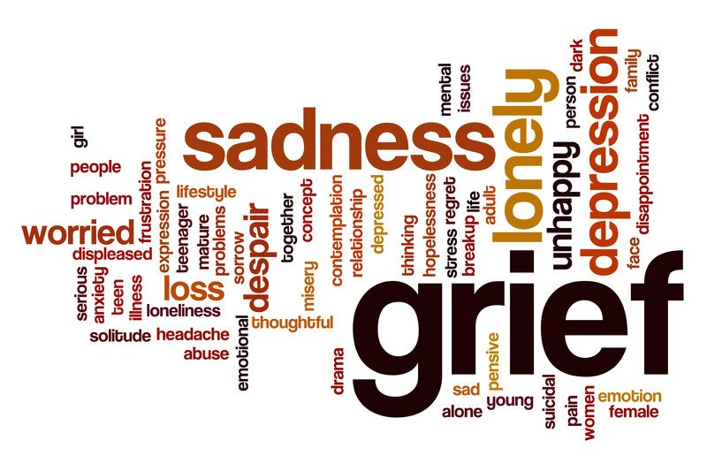
4. Bereavement
The death of a loved is one of the most difficult emotional experiences an individual has to suffer. The pain and grief can feel debilitating and often overwhelming. Grief is not just one feeling. It is a multitude of emotions and reactions which affect how we think and behave and continues long after the passing which triggered it. Being bereaved can be an extremely lonely time. Talking with friends and family can be one of the most helpful ways to cope after someone close to us dies. One of the particular challenges of loss during the COVID-19 pandemic is that increasing numbers of people and households are being told to self-isolate or socially distance from friends and family.
Bereavement, is often difficult under any situation, however COVID-19 will exacerbate these emotions.
Those who have experienced loss because of COVID-19 will have had little or limited opportunity to say goodbye to their loved ones which can be particularly upsetting. This lack of closure will intensify during periods of isolation/social distancing, therefore support and interventions are needed to support the long term impact of the bereavement.
The Nottingham and Nottinghamshire system has seen this following COVID-19 and Non COVID-19 deaths. This ultimately means that friends and families have most likely lost someone close to them, and were unable to gain the intimate support of friends, family and loved ones to support the bereavement process of healing. This cohort should be an initial focus where support teams take a light touch approach to signpost and guide to existing services that are available that could prevent mental health issues/depression escalating.
Nottingham/Nottinghamshire – 1.1m population the following has been identified:
Between the week commencing 6th March 2020 (when the first deaths in the LRF population occurred) and 12th June, at total of 854 deaths were due to COVID-19. Assume could rise to c.1,000
Assume 5 people close family per person - 30-35% = c.1,700-2,500 people need non-specialist support, 10% need specialist support, with the remainder needing information only
Assume additional 10-15 people suffering bereavement per person = 12,500 - 18,400 people needing low-level support
Non-COVID-19
About 2,000 non-COVID-19 deaths between mid-March and mid-June
Assume 5 people close family per person - 33-50% needing intensive support = c.3,400-5,000 people
Assume additional 10-15 people suffering bereavement per person = 25,000 - 37,000 people needing low-level support

Slide 27
4. Interventions to support bereavement
Supporting our population to cope with bereavement during and after a pandemic
Provide support on potential experiences of bereavement through first and potential 2nd wave pandemic
Tailored bereavement support for families where the death was attributed to COVID-19
Unable to say goodbye
Providing financial guidance to manage funeral costs.
Offer guidance
/signposting on how to manage anticipatory bereavement
Signpost bereavement support for families of suicide
Providing mental help support to manage stress and anxiety for those who have suffered a bereavement
Target extra support and specialist counselling to most vulnerable and those with on-going difficulties
Example | Evaluation
Patients struggling to cope with a loss, should be encouraged to self refer to existing IAPT and community mental health services, or directed to the national bereavement phone line 0800 2600 400. This service is open daily from 8am—8pm. Other charities available to support bereavement at this time are:- · www.samaritans.org · www.thegoodgrieftrust.org · www.cruse.org.uk | No accessing national bereavement line Self referrals to IAPT No accessing community groups/voluntary support No experiencing bereavement through COVID-19-19 No of deaths throughout “social distancing period” No of suicides
Example Interventions:

Slide 28
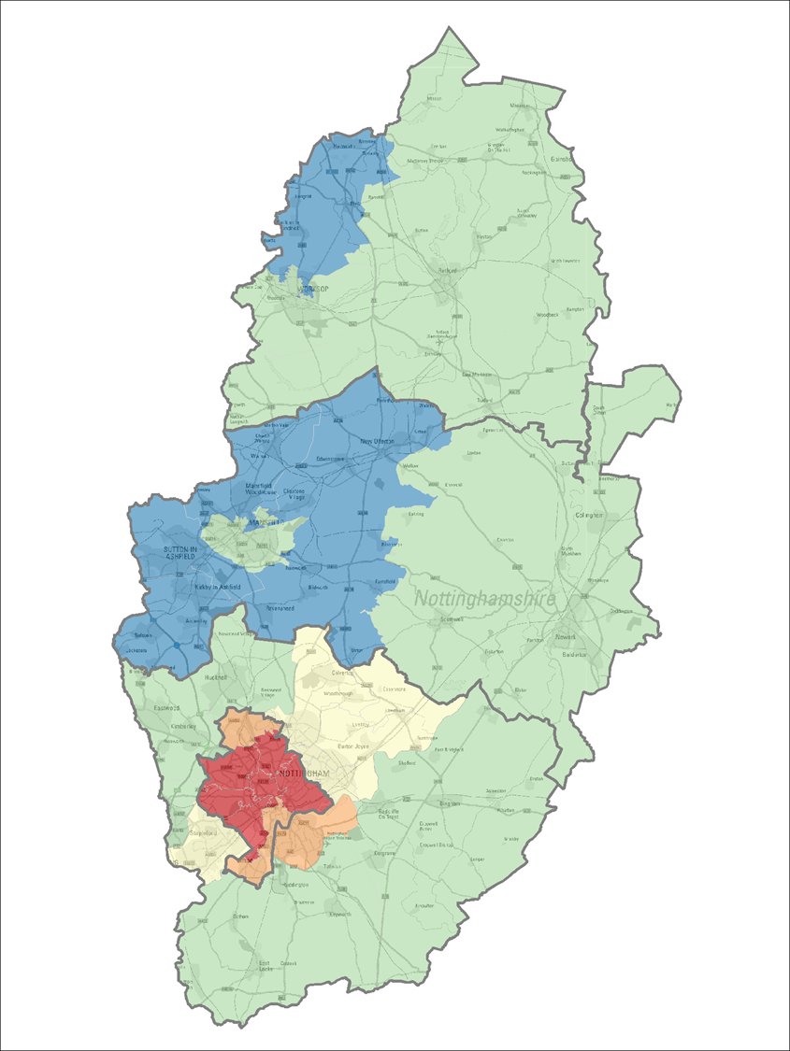
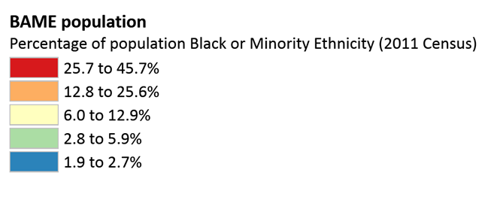
5. BAME Groups
We know that people from Black, Asian and Minority Ethnic (BAME) backgrounds have been disproportionally impacted by COVID-19. For those with confirmed COVID-19 infection, it was shown that mortality rates were higher in a number of ethnic groups. Co-morbidities and socio-economic status are being put forward as possible explanations for the high number of people from BAME groups affected, but it is important not to assume that correlation equals causation. The system will need to ensure a transparent collection and reporting of ethnicity data to understand the full impact of COVID-19 on BAME patients, This is being monitored by the Data and Information Cell as the situation is changing quickly as more knowledge becomes available.
The biggest increase in mortality risk was seen in those of Bangladeshi ethnicity, where the risk of mortality was twice that of White ethnicity. For COVID-19 patients of Chinese, Indian, Pakistani, Other Asian, Caribbean and Other Black ethnic groups, there was an increased risk of mortality of between 10 and 50%. This analysis accounted for the age, sex, deprivation and region of the patients included in the analysis.
It is not surprising that these communities will be extremely apprehensive moving forward from lockdown into “normal life” and will require targeted focus and support using the interventions mentioned in previous sections.
Nottingham/Nottinghamshire – 1.1m population the following has been identified:
Approx. 190,000 people are BAME (140,000 City, 34,000 South, 14,000 Mid)
Approx. 41,000 people (3.7%) are Black (34,000 City, 5,000 South, 2,000 Mid)
Approx. 92,000 people (8.3%) are Asian (72,000 City, 16,000 South, 5,000 Mid)
Approx. 38,000 people (3.4%) are Mixed Race (23,000 City, 9,000 South, 5,000 Mid)
Approx. 17,000 people (1.5%) are Other (11,000 City, 3,000 South, 3,000 Mid)
Less that 4,000 people in Bassetlaw are BAME (3.5%)

Slide 29
Interventions to support BAME
Community groups and community hubs to share information on how to manage the anxieties/fears of COVID-19
Ensure information is easily accessible in multiple languages and formats
Prepare for an increase in activity of between 5-20% for services such as IAPT, CMHT
Work with community groups to co-create support bubbles for individuals who have had a mental health diagnosis
Support at risk occupations i.e.. key workers, drivers, AHPs where exposure is highest and anxieties of returning to normal may be greatest
Work with volunteer groups to identify occupations i.e.. key workers, drivers, AHPs where exposure is highest and Signpost/guide on how to stay safe
Work with places of worship to/faith communities to support key messages around safety, symptoms and self care
Ensure media and communications on potential outbreaks and how to respond are culturally appropriate and accessible in multiple languages
Work with faith groups and community services to build trust with health and care services (bridging unmet need)
Ensure mental health awareness and suicide awareness training is available for faith and community groups
Example | Evaluation
Government have translated the guidance for self-isolation and social distancing into a number of languages. The documents can be found here: https://www.gov.uk/government/publications/COVID-19 stay-at-home-guidance https://www.gov.uk/government/publications/COVID-19-guidance-on-social-distancing-and-for-vulnerable-people Doctors of The World have also published COVID-19 guidance for patients in a number of languages (and continue to add more). https://www.doctorsoftheworld.org.uk/?gclid=EAIaIQobChMIw5DvqeqY6gIVj-3tCh1u-A_GEAAYASAAEgJ5rfD_BwE A guide on Coping Strategies in Anxious Times, produced by The Traumatic Stress Service in Bristol includes practical advice and translated into 13 languages. http://www.awp.nhs.uk/news-publications/publications/patient-information/translated/ A storybook for children 6-11 https://interagencystandingcommittee.org/iasc-reference-group-mental-health-and-psychosocial-support-emergency-settings/my-hero-you Ensure mental health awareness and suicide awareness training is available for frontline workers eg. utilising Nottingham and Nottinghamshire Suicide Prevention Action Plan | No supported by Community groups Identify at risk workforce through risk assessment BAME broken down by place BAME with history of MH condition BAME in receipt of free school meals BAME receiving universal credit BAME and potential high risk hot spot areas BAME and occupation
Notes:
https://interagencystandingcommittee.org/iasc-reference-group-mental-health-and-psychosocial-support-emergency-settings/my-hero-you

Slide 30
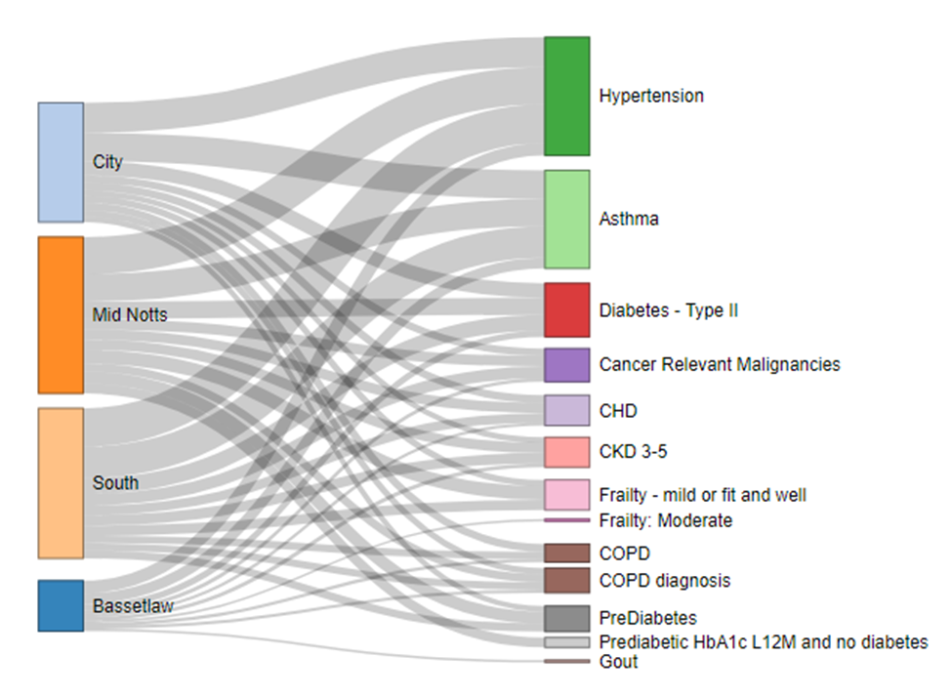
Those with multiple Long Term Conditions (LTCs)
In order to save lives, the system has needed to divert its attention to managing the pandemic and in some cases this could result in gaps in care in LTC management. This cohort may experience intense feelings of anxiety and stress either because of a change in routine in care (existing services diverted to manage the pandemic), feel that they are vulnerable because of their health condition, or that they too should be “shielded” protected. Stress can exacerbate some LTCs, as can inactivity, changes to diet, and issues with accessing healthcare. All of these factors are likely to exacerbate mental wellness.
While very little evidence on pandemic research and LTC is available, the World Health Organisation has noted that there is an interaction between LTCs and deprivation levels. The national library of medicine has published a review (Special Populations Disaster Care Considerations in Chronically Ill, Pregnant, and Morbidly Obese Patients, 2019) in which it highlighted that patients with complex, chronic medical conditions are at an increased risk of morbidity and mortality when normal health care services are disrupted. Named within these cohorts were those who were chronically hospitalised, people in chronic care facilities, people dependent on technology for disease management, people who are oxygen dependent, people dependent on ventricular assist devices, people on chronic dialysis, people who are immunosuppressed, transplant patients, end-stage chronic disease, pregnancy, and those with BMI ≥40 kg/m2.
Therefore as a system in order to mitigate exacerbation of anxieties, stress and LTCs it would be prudent when looking to “restart” services that focus is given to above areas first, particularly areas of higher deprivation in order to reduce the risk of exacerbation of their LTC during and after the pandemic.
Nottingham/Nottinghamshire – 1.1m population the following has been identified:
21,980 people with COPD, 6,825 have depression (31%)
111,370 people with asthma, 26,125 have depression (23%)
64,405 people with diabetes, 15,510 with depression (24%)
148,395 people with HTN, 31,635 with depression (21%)
10,495 people with HF, 2,195 with depression (21%)
8,115 people with LVF, 1,755 with depression (22%)
21,565 people with AF, 3,840 with depression (18%)
(cf depression 14.9% in total ICS population)
LTC – ICP’s

Slide 31
Interventions for those with multiple Long Term Conditions (LTC)
Remove risk of exacerbations caused by anxieties and stress by supporting self care, promoting self management and creating trust
Work with community support teams/link workers to follow up missed appointments
Making Every Contact Count (MECC)
Provide on-going reassurance and general support, develop a system strategy that develops trust in health and care
Model unmet need, to prevent further escalation
Targeted support for:-
Those dependent on technology for disease management, oxygen dependent, dependent on ventricular assist devices, on chronic dialysis, immunosuppressed, transplant patients, end-stage chronic disease, pregnancy, and those with BMI ≥40 kg/m2.
prepare for winter months. Focus on Hypertension, diabetes and respiratory services
Ensure provision of mental and emotional wellbeing self-care information (e.g. 5 ways to wellbeing
Example | Evaluation
https://www.makingeverycontactcount.co.uk/ Nottinghamshire Voluntary Service - https://www.nottinghamcvs.co.uk/ Primary care registers to identify and actively approach those at highest risk through existing long term management services. Ensure provision of mental and emotional wellbeing self-care information (e.g. 5 ways to wellbeing | No of population with Multiple LTC No of vulnerable by place Reduction in UC No of support packages in place No of volunteers in place No of shielded No of support request into Community Hubs No of unmet requests into Community Hubs No identified through Care navigators

Slide 32

7. Workforce
COVID-19 is having an impact on the mental wellbeing of frontline staff with rates of anxiety and burnout starting to be reported. Our frontline health and care workers are making choices that are not easy to make — between protecting oneself and one’s family and doing the job. Our rapid assessment research identified high rates of mental health issues, including depression, anxiety, insomnia, and distress, which are much higher in nurses, women, and those on the front line when responding to an emergency. To mitigate this the British Psychological Society https://www.bps.org.uk/ has outlined three phases of support for NHS staff as they respond to COVID-19. These best practice guidelines could also be adopted for any frontline /key workforce, these being-
A. Preparation
B. Active
C. Recovery
A. Preparation phase, individuals are more likely to experience anticipatory anxiety about the unknown potential of the outbreak on their personal and working lives. Therefore the following is recommended for this phase.
· Have a clear communication strategy
· Visible Leadership
· Enhanced Management Support
· Ensure Safety Provisions are in place and visible
· Sign posting and offering of peer support
B. Active phase, During this phase, staff are more likely to experience a sense of rising to a challenge and increased camaraderie as people come together. This can result in staff losing usual boundaries over working hours and breaks and letting social niceties slip as the focus turns to getting things done. This pandemic is likely to create sustained pressure lasting weeks/months. It is expected staff may experience disillusionment and exhaustion.
This is the highest period of psychological risk where staff may neglect their physical and psychological self by putting work above their own wellbeing. It is recommended in this phase that employers:
Normalising psychological responses – reminding staff this an unprecedented situation and giving them permission to step back, take breaks and discuss their emotional wellbeing.
Delivering formal psychological care in stepped ways – Organisations may want to review their support for staff and expand provisions where possible, which could include, trauma risk management (TRiM), Schwartz rounds, engagement, and deployment of existing in-house clinical psychology teams.
Providing psychological care - In addition to the changing nature of work, staff may also be dealing with patient deaths, as well as dealing with sick and/or dying family members and friends. Practitioner psychologists can help employers understand how frontline staff manage patient and family fears and concerns. Organisations may want to speak to and prepare their chaplains and counselling services as they will have a key role in supporting staff.
C. Recovery phase, In this phase, staff are expected to experience recovery and, in some cases, potentially the long-term psychological impacts of the outbreak. Having time to reflect, some individuals may experience a sense of regret over what they ‘should’ have done differently and shame or guilt.
Allowing time and space for staff to take stock and seek help if needed.
Using locally contracted MH services, community offers (IAPT) to facilitate reflection and processing of experiences.
Allowing time for feedback from staff about what their mental wellbeing needs are and how they can be best supported.
Continuing the on-going peer support/hubs
Estimated 10,000 people affected
Acute & ambulance - 4,000 (25%)
Care Homes - 4,400 (35%)
Community & MH - 900 (15%)
Primary Care - 220 (15%)
City and County Councils - 100 (5%)
Police, Fire & Rescue - 130 (2.5-5%)
District & Borough Councils 10-15 (2.5%)

Slide 33
Workforce Interventions
Adopt the three phased approach
1. Preparation
2. Active
3. Recovery
Plan for fatigue, directly following the peak..
Offer outreach, peer to peer support for key workers and frontline staff
Ensure staff receive regular communications and intelligence to feel informed, involved and valued
Ensure a rigorous risk assessment is carried out for all staff
Watch for burnout. Ensure that responsibilities and requests are being equally shared among the workforce
Ensure mental health awareness and suicide awareness training is avaible for frontline workers
Example | Evaluation
Local Government - https://local.gov.uk/our-support/coronavirus-information-councils/COVID-19support-your-role/COVID-19workforce NHS Workforce - https://www.england.nhs.uk/coronavirus/workforce/ Local PR actioner - https://www.practitionerhealth.nhs.uk/COVID-19workforce-wellbeing Volunteer support - https://www.healthysurrey.org.uk/professionals/COVID-19 Ensure mental health awareness and suicide awareness training is available for frontline workers eg. utilising Nottingham and Nottinghamshire Suicide Prevention Action Plan | No of staff from BAME community No of staff (keyworkers/frontline) No of COVID-19 assessments undertaken No of staff classed as essential worker Workforce broken down by BAME And occupation No “clicking” on workforce newsletter No of staff not taken AL within last 3 months No of workforce from partner organisations No of referrals to counselling support No of referrals to Occupation Health

Slide 34
References
Vos, T., et al. (2013) Global, regional, and national incidence, prevalence, and years lived with disability for 301 acute and chronic diseases and injuries in 188 countries, 1990–2013: a systematic analysis for the Global Burden of Disease Study. The Lancet. 386 (9995). pp. 743-800.
Lozano, R. et al. (2012) Global and regional mortality from 235 causes of death for 20 age groups in 1990 and 2010. a systematic analysis for the global burden of disease study 2010. The Lancet. 380(9859), pp. 2095–2128.
Whiteford, H. A. et al. (2013) Global burden of disease attributable to mental and substance use disorders: findings from the Global Burden of Disease Study 2010. The Lancet. 382 (9904). pp. 1575-1586.
McManus S, Bebbington P, Jenkins R, Brugha T. (eds.) (2016) Mental health and wellbeing in England: Adult Psychiatric Morbidity Survey 2014. Leeds: NHS Digital. Available at: http://content.digital.nhs.uk/catalogue/PUB21748/apms-2014-full-rpt.pdf [Accesed 5 October 2016]
https://journals.plos.org/plosone/article?id=10.1371/journal.pone.0019590
https://onlinelibrary.wiley.com/doi/full/10.1002/wps.20128
https://www.cambridge.org/core/journals/the-british-journal-of-psychiatry/article/mortality-gap-for-people-with-bipolar-disorder-and-schizophrenia-ukbased-cohort-study-20002014/2A65056E571CD8F1E66249DF01BFAF5A
https://www.gov.uk/government/publications/severe-mental-illness-smi-physical-health-inequalities/severe-mental-illness-and-physical-health-inequalities-briefing
Mental Health Foundation. The COVID-19 Pandemic, Financial Inequality and Mental Health. London; Available from: https://www.mentalhealth.org.uk/coronavirus/looking-after-your-mental-health-during-coronavirus-outbreak
Source: Office for National Statistics release, 23/06/2020
https://www.gov.uk/government/publications/severe-mental-illness-smi-physical-health-inequalities/severe-mental-illness-and-physical-health-inequalities-briefing
https://digital.nhs.uk/data-and-information/publications/statistical/quality-and-outcomes-framework-achievement-prevalence-and-exceptions-data/2018-19-pas
World Health Organisation. Inter-Agency Standing Committee briefing note – Addressing mental health and psychosocial aspects of COVID-19 outbreak. 17 March 2020 (accessed 21.5.20).
Wilton, Jo. Briefing 56: Trauma, mental health and coronavirus. Supporting healing and recovery Centre for Mental Health. 5th May 2020 (accessed 21.5.20)
Noble, J., Martin, F. et al, 2020, The potential impact of COVID-19 on mental health outcomes and the implications for service solutions. NIHR / University of Bristol.
Goldmann, E., & Galea, S. (2014). Mental health consequences of disasters. Annual review of public health, 35, 169-183.
Wade, D., Crompton, D., Howard, A., Stevens, N., Metcalf, O., Brymer, M., ... & Forbes, D. (2014). Skills for Psychological Recovery: Evaluation of a post-disaster mental health training program. Disaster health, 2(3-4), 138-145.
Flores, E. C., Fuhr, D. C., Bayer, A. M., Lescano, A. G., Thorogood, N., & Simms, V. (2018). Mental health impact of social capital interventions: a systematic review. Social psychiatry and psychiatric epidemiology, 53(2), 107-119.
Chew QH; Wei KC; Vasoo S; Chua HC; Sim K Narrative synthesis of psychological and coping responses towards emerging infectious disease outbreaks in the general population: practical considerations for the COVID-19 pandemic. Singapore medical journal; Apr 2020
Chew QH; Wei KC; Vasoo S; Chua HC; Sim K Narrative synthesis of psychological and coping responses towards emerging infectious disease outbreaks in the general population: practical considerations for the COVID-19 pandemic. Singapore medical journal; Apr 2020
Li, W. et al. (2020) ‘Progression of Mental Health Services during the COVID-19 Outbreak in China’, International journal of biological sciences, 16(10), pp. 1732–1738. doi: 10.7150/ijbs.45120. https://www.ncbi.nlm.nih.gov/pmc/articles/PMC7098037/
Bauerle A.; Skoda E.-M.; Dorrie N.; Teufel M.; Bottcher J. Psychological support in times of COVID-19: the Essen community-based CoPE concept. Journal of public health (Oxford, England); Apr 2020
Available at: Journal of public health (Oxford, England) - from Oxford Journals A - Z Available to PHE and Local Authority staff
Chaturvedi, S. K. (2020) ‘COVID-19, Coronavirus and Mental Health Rehabilitation at Times of Crisis’, Journal of Psychosocial Rehabilitation & Mental Health, 7(1), p. 1 https://link.springer.com/content/pdf/10.1007/s40737-020-00162-z.pdf
Douglas, M., Katikireddi, S.V., Taulbut, M., McKee, M., and McCartney, G. 2020. Mitigating the wider health effects of COVID-19 pandemic response. British Medical Journal [online]. Available from: https://www.bmj.com/content/369/bmj.m1557
Smith, Katharine; Ostinelli, Edoardo; Cipriani, Andrea. COVID-19 and mental health: a transformational opportunity to apply an evidence-based approach to clinical practice and research . Evidence-based mental health; May 2020; vol. 23 (no. 2). (Accessed 22.5.20)
Hao Yao†, Jian-Hua Chen†‡, *Yi-Feng Xu‡, 2020, Patients with mental health disorders in the COVID-19 epidemic, https://www.thelancet.com/action/showPdf?pii=S2215-0366%2820%2930090-0https://www.thelancet.com/action/showPdf?pii=S2215-0366%2820%2930090-0
Marsden, J., Darke, S., Hall, W. et al. (6 more authors) (2020), Mitigating and learning from the impact of COVID-19 infection on addictive disorders.. Addiction published by John Wiley & Sons Ltd on behalf of Society for the Study of Addiction http://eprints.whiterose.ac.uk/160151/1/add.15080.pdf
Clay, J.M. and Parker, M.O. 2020, Alcohol use and misuse during the COVID-19 pandemic: a potential public health crisis?, The Lancet [online].
Recessions and health: The long-term health consequences of responses to coronavirus, Institute for Fiscal Studies , 9th April 2020
Barr, B., Taylor-Robinson, D., Scott-Samuel, A., McKee, M., & Stuckler, D. (2012). Suicides associated with the 2008-10 economic recession in England: time trend analysis. Bmj, 345, e5142.
Katikireddi, S. V., Niedzwiedz, C. L., & Popham, F. (2012). Trends in population mental health before and after the 2008 recession: a repeat cross-sectional analysis of the 1991–2010 Health Surveys of England. BMJ open, 2(5), e001790.
Burkle Jr, Frederick M (2011). The limits to our capacity: reflections on resiliency, community engagement, and recovery in 21st-century crises. Disaster Medicine & Public Health Preparedness; Sep 2011; vol. 5. Available at Disaster Medicine and Public Health Preparedness
Lindström, M. and Giordano, G. N. (2016) ‘The 2008 financial crisis: Changes in social capital and its association with psychological wellbeing in the United Kingdom – A panel study’, Social Science & Medicine, 153, pp. 71–80. doi: 10.1016/j.socscimed.2016.02.008. https://www.sciencedirect.com/science/article/pii/S0277953616300636?via%3Dihub

Slide 35
Garfin, D., Silver, R. and Holman, E., 2020. The novel coronavirus (COVID-19 2019) outbreak: Amplification of public health consequences by media exposure. Health Psychology [online] Available from: https://psycnet.apa.org/fulltext/2020-20168-001.html [Accessed 12 May 2020].
Huang, Y. and Zhao, N. 2020. Generalized anxiety disorder, depressive symptoms and sleep quality during COVID-19 epidemic in China: a web-based cross-sectional survey. Psychiatry Research [online]. Available from: https://www.ncbi.nlm.nih.gov/pmc/articles/PMC7152913/
Farooq Naeem, Muhammad Irfan and Afzal Javed (2020) ‘Coping with COVID-19: Urgent Need for Building Resilience through Cognitive Behaviour Therapy’, Khyber Medical University Journal, 12(1). doi: 10.35845/kmuj.2020.20194. https://doaj.org/article/25e7c3b243f44add893598d6c12c1a7d
Rajkumar, R. P. (2020) ‘COVID-19 and mental health: A review of the existing literature’, Asian journal of psychiatry, 52, p. 102066. doi: 10.1016/j.ajp.2020.102066.
Liu N.; Zhang F.; Wei C.; Jia Y.; Shang Z.; Sun L.; Wu L.; Sun Z.; Zhou Y.; Wang Y.; Liu W. Prevalence and predictors of PTSS during COVID-19 outbreak in China hardest-hit areas: Gender differences matter. Psychiatry Research; May 2020; vol. 287
Beaglehole, B., Mulder, R. T., Boden, J. M., & Bell, C. J. (2019). A systematic review of the psychological impacts of the Canterbury earthquakes on mental health. Australian and New Zealand journal of public health, 43(3), 274-280.
Wang C.; Pan R.; Wan X.; Tan Y.; Xu L.; Ho R.C.; Ho C.S. Immediate psychological responses and associated factors during the initial stage of the 2019 coronavirus disease (COVID-19) epidemic among the general population in China. International Journal of Environmental Research and Public Health; Mar 2020; vol. 17 (no. 5)
Wang, C., Pan, R., Wan, X., Tan, Y., Xu, L., McIntyre, R.S., Choo, F.N., Tran, B., Ho, R., Sharma, V.K., and Ho C. 2020. A longitudinal study on the mental health of general population during the COVID-19 epidemic in China. Brain Behavior and Immunity [online]. Available from: https://www.sciencedirect.com/science/article/pii/S0889159120305110
Zhou, X. et al. (2020) ‘The Role of Telehealth in Reducing the Mental Health Burden from COVID-19, Telemedicine & e-Health, 26(4), pp. 377–379. doi: 10.1089/tmj.2020.0068.
A Second Pandemic: Mental Health Spillover From the Novel Coronavirus (COVID-19). J Am Psychiatr Nurses Assoc. 2020 Apr 27:1078390320919803. doi: 10.1177/1078390320919803. [Epub ahead of print]
The Inverse Response Law: Theory and Relevance to the Aftermath of Disasters Int J Environ Res Public Health. 2018 May; 15(5): 916
Suicide risk and prevention during the COVID-19pandemic, The Lancet Psychiatry, 21 April 2020
https://www.thelancet.com/action/showPdf?pii=S2215-0366%2820%2930171-1
COVID-19-19 19 and its mental health consequences J Ment Health 2020 Apr 27:1-2. doi: 10.1080/09638237.2020.1757052. [Epub ahead of print]
The University of Sheffield, Ulster University. COVID-19Psychological Research Consortium (C19PRC). 2020. Initial research findings on COVID-19-19-19 and mental health in the UK [online]. Available from: https://drive.google.com/file/d/1A95KvikwK32ZAX387nGPNBCnoFktdumm/view
Timely mental health care for the 2019 novel coronavirus outbreak is urgently needed. The Lancet Psychiatry, 7(3), 228-229
Multidisciplinary research priorities for the COVID-19 pandemic: a call for action for mental health science. The Lancet Psychiatry.
Brooks, S.K., Webster, R.K., Smith, L.E., Woodland, L., Wessley, S., Greenberg, N., and Rubin, G.J. The psychological impact of quarantine and how to reduce it: rapid review of the evidence. The Lancet [online]. 2020
Douglas, M., Katikireddi, S.V., Taulbut, M., McKee, M., and McCartney, G. Mitigating the wider health effects of COVID-19 pandemic response. British Medical Journal [online]. 27 April 2020 (accessed 21.5.20)
Prof. Neil Greenberg. “Going for Growth” An outline NHS staff recovery plan post-COVID-19-1919 (outbreak 1). Royal College of psychiatrists. 7th May 2020 (accessed 21.5.20).
Bloomfield et al. Coordinating the response. COVID-19-19 Trauma Response Working Group. 2020 (accessed 22.5.20).
Calder, K., D’Aeth, L., Turner, S., Fox, C., & Begg, A. (2016). Evaluation of a well-being campaign following a natural disaster in Christchurch, New Zealand. International Journal of Mental Health Promotion, 18(4), 222-233.
Rose SC, Bisson J, Churchill R, Wessely S. Psychological debriefing for preventing post traumatic stress disorder (PTSD). Cochrane Database of Systematic Reviews 2002, Issue 2.
Rose SC, Bisson J, Churchill R, Wessely S. Psychological debriefing for preventing post traumatic stress disorder (PTSD). Cochrane Database of Systematic Reviews 2002, Issue 2.
Brooks, S.K., Webster, R.K., Smith, L.E., Woodland, L., Wessley, S., Greenberg, N., and Rubin, G.J. 2020. The psychological impact of quarantine and how to reduce it: rapid review of the evidence. The Lancet [online]. Available from: https://www.thelancet.com/pdfs/journals/lancet/PIIS0140-6736(20)30460-8.pdf
DePierro, J., Lowe, S. and Katz, C. (2020) ‘Lessons learned from 9/11: Mental health perspectives on the COVID-19 pandemic’, Psychiatry Research, 288. doi: 10.1016/j.psychres.2020.113024.
Li, W. et al. (2020) ‘Progression of Mental Health Services during the COVID-19 Outbreak in China’, International journal of biological sciences, 16(10), pp. 1732–1738. doi: 10.7150/ijbs.45120. https://www.ncbi.nlm.nih.gov/pmc/articles/PMC7098037/
Noble, J., Martin, F. et al, 2020, The potential impact of COVID-19 on mental health outcomes and the implications for service solutions. NIHR / University of Bristol.
Brooks, S. K. et al. (2018) ‘Training and post-disaster interventions for the psychological impacts on disaster-exposed employees: a systematic review’, Journal of mental health (Abingdon, England), pp. 1–25. doi: 10.1080/09638237.2018.1437610.
Brooks, S. K., Rubin, G. J., & Greenberg, N. (2019). Traumatic stress within disaster-exposed occupations: overview of the literature and suggestions for the management of traumatic stress in the workplace. British medical bulletin.
Brooks, S., Rubin, G. J., & Greenberg, N. (2019). Managing traumatic stress in the workplace. Occupational Medicine, 69, 2–4
Greenberg, N. et al. (2020) ‘Managing mental health challenges faced by healthcare workers during COVID-19 pandemic’, BMJ: British Medical Journal (Online content). Mar 2020 (accessed 21.5.20).
Cabello,R I., Echavez, M.J.F., Serrano-Ripoll, M.J., Navarro, F.D., Fiol de Roque, M.A., Pastor Moreno, G., et al. 2020. Impact of viral epidemic outbreaks on mental health of healthcare workers: a rapid systematic review , Available from: https://www.medrxiv.org/content/10.1101/2020.04.02.20048892v1

Slide 36
Cates D.S., Gomes P.G., Krasilovsky A.M. (2018). Behavioral Health Support for Patients, Families, and Healthcare Workers. In: Hewlett A., K. Murthy A. (eds) Bioemergency Planning. Springer, Cham https://link.springer.com/chapter/10.1007%2F978-3-319-77032-1_16
Lai, J., Ma, S., Wang, Y., Cai, Z., Hu, J., Wei, N., et al. 2020. Factors Associated With Mental Health Outcomes Among Health Care Workers Exposed to Coronavirus Disease 2019. JAMA Network [online]. Available from: http://scholar.google.co.uk/scholar_url?url=https://jamanetwork.com/journals/jamanetworkopen/articlepdf/2763229/lai_2020_oi_200192.pdf&hl=en&sa=X&scisig=AAGBfm15J6-c4HXsNkvKiHvg_F6R7y0q0w&nossl=1&oi=scholarr
Albott, Cristina Sophia; Wozniak, Jeffrey R; McGlinch, Brian P; Wall, Michael H; Gold, Barbara S; Vinogradov, Sophia. Battle Buddies: Rapid Deployment of a Psychological Resilience Intervention for Healthcare Workers during the COVID-19 Pandemic. Anesthesia and analgesia; Apr 2020
Tan W.; Ho R.; Hao F.; Jiang L.; Zhang L.; Zhao X.; Zou Y.; Hu Y.; Luo X.; McIntyre R.S.; Jiang X.; Zhang Z.; Lai A.; Ho C.; Tran B.; Tam W. Is returning to work during the COVID-19 pandemic stressful? A study on immediate mental health status and psychoneuroimmunity prevention measures of Chinese workforce Brain, Behavior, and Immunity; 2020
Shanafelt, T., Ripp, J., and Trockel, M. 2020. Understanding and Addressing Sources of Anxiety Among Health Care Professionals During the COVID-19 Pandemic. JAMA [online]. Available from: https://jamanetwork.com/journals/jama/fullarticle/2764380
Guidance for planners of the psychosocial response to stress experienced by hospital staff associated with COVID-19-19: Early Interventions Version 3 7th April 2020 COVID-19-19 Trauma Response Working Group Guidance available here: https://www.traumagroup.org/
Bo H.-X.; Wang Y.; Wu X.; Li W.; Yang Y.; Xiang Y.-T.; Zhang Q.; Cheung T. Posttraumatic stress symptoms and attitude toward crisis mental health services among clinically stable patients with COVID-19 in China. Psychological medicine; Mar 2020 ; p. 1-7 (accessed 22.5.20)
Hassaan Ahmed, et al .(2020). Long-term Clinical Outcomes in Survivors of Coronavirus Outbreaks after hospitalisation or ICU admission: a Systematic Review and Meta-analysis of Follow-up Studies. medRxiv 2020.04.16.20067975; doi: https://doi.org/10.1101/2020.04.16.20067975
Shah, K. et al. (2020) ‘Focus on Mental Health During the Coronavirus (COVID-19-19-19) Pandemic: Applying Learnings from the Past Outbreaks’, Cureus, 12(3), p. e7405. doi: 10.7759/cureus.7405.
Troyer, E.A., Kohn, J.N., Hong, S., Are we facing a crashing wave of neuropsychiatric sequelae of COVID-19-19-19? Neuropsychiatric symptoms and potential immunologic mechanisms, Brain, Behavior, and Immunity (2020), doi: https://doi.org/10.1016/j.bbi.2020.04.027
Survivors of ICU
Cates D.S., Gomes P.G., Krasilovsky A.M. (2018). Behavioral Health Support for Patients,
Families, and Healthcare Workers. In: Hewlett A., K. Murthy A. (eds) Bioemergency Planning. Springer, Cham https://link.springer.com/chapter/10.1007%2F978-3-319-77032-1_16
Li, W. et al. (2020) ‘Progression of Mental Health Services during the COVID-19 Outbreak in China’, International journal of biological sciences, 16(10), pp. 1732–1738. doi: 10.7150/ijbs.45120. https://www.ncbi.nlm.nih.gov/pmc/articles/PMC7098037/
Moldofsky, H. and Patcai, J. (2011) ‘Chronic widespread musculoskeletal pain, fatigue, depression and disordered sleep in chronic post-SARS syndrome; a case-controlled study’, BMC neurology, 11, p. 37. doi: 10.1186/1471-2377-11-37.
Ratzer M, Brink O, Knudsen L, Elklit A. Post traumatic stress in intensive care unit survivors – a prospective study. 2014. Health Psychology & Behavioural Medicine [onine]. Available from: https://www.ncbi.nlm.nih.gov/pmc/articles/PMC4346029/ [Accessed 12 May 2020].
STAM, H. J., STUCKI, G. and BICKENBACH, J. (2020) ‘COVID-19 and Post Intensive Care Syndrome: A Call for Action’, Journal of Rehabilitation Medicine (Stiftelsen Rehabiliteringsinformation), 52(4), pp. 1–4. doi: 10.2340/16501977-2677
Wu, Chaomin et al, (2020). Mental Health Status of Survivors Following COVID-19 in Wuhan, China: A Descriptive Study (3/19/2020). Pre-print Available at SSRN: https://ssrn.com/abstract=3559616 or http://dx.doi.org/10.2139/ssrn.3559616
Meeting the psychological needs of people recovering from severe coronavirus (COVID-19-19-19) Other guidance and webinars available from: https://www.bps.org.uk/responding-coronavirus
Penny, A., and Relf, M., 2017. A guide to commissioning bereavement services in England 2017. National Bereavement Alliance [online]. Available from: https://nationalbereavementalliance.org.uk/wp-content/uploads/2017/07/A-Guide-to-Commissioning-Bereavement-Services-in-England-WEB.pdf
Wang, H. et al. (2020) ‘Dementia care during COVID-19-19-19’, Lancet, 395(10231), pp. 1190–1191. doi: 10.1016/S0140-6736(20)30755-8
Liang, Leilei; Ren, Hui; Cao, Ruilin; Hu, Yueyang; Qin, Zeying; Li, Chuanen; Mei, Songli. The effect of COVID-19 on youth mental health. Psychiatric Quarterly; Apr 2020
Dalton, Louise; Rapa, Elizabeth; Stein, Alan Protecting the psychological health of children through effective communication about COVID-19-19-19. The Lancet. Child & adolescent health; May 2020; vol. 4 (no. 5); p. 346-347 (accessed 22.5.20)
Liu, Jia Jia; Bao, Yanping; Huang, Xiaolin; Shi, Jie; Lu, Lin. Mental health considerations for children quarantined because of COVID-19-19-19. The Lancet. Child & adolescent health; May 2020; vol. 4 (no. 5); p. 347-349
Kar, N. (2009) ‘Psychological impact of disasters on children: review of assessment and interventions’, World journal of pediatrics : WJP, 5(1), pp. 5–11. doi: 10.1007/s12519-009-0001-x.
Sprang, G., and Silman, M. 2013. Posttraumatic stress disorder in parents and youth after health­related disasters. Disaster Medicine and Public Health Preparedness [online]. Available from: https://www.researchgate.net/publication/259432942_Posttraumatic_Stress_Disorder_in_Parents_and_Youth_After_Health-Related_Disasters
Children in lockdown: what coronavirus means for UK children, UNICEF, https://www.unicef.org.uk/coronavirus-children-in-lockdown/
Royal College of Psychiatrists. Digital - COVID-19 guidance for clinicians. Page last updated: 20 March 2020. (accessed 22.5.20).
de Girolamo, Giovanni; Cerveri, Giancarlo; Clerici, Massimo; Monzani, Emiliano; Spinogatti, Franco; Starace, Fabrizio; Tura, Giambattista; Vita, Antonio. Mental Health in the Coronavirus Disease 2019 Emergency-The Italian Response. JAMA psychiatry; Apr 2020
Percudani M.; Corradin M.; Moreno M.; Indelicato A.; Vita A.Mental Health Services in Lombardy during COVID-19 outbreak. Psychiatry Research; Jun 2020; vol. 288 (Accessed 21.5.20)
Ćosić, Krešimir; Popović, Siniša; Šarlija, Marko; Kesedžić, Ivan . Impact of Human Disasters and COVID-19 Pandemic on Mental Health: Potential of Digital Psychiatry. Psychiatria Danubina; 2020; vol. 32 (no. 1); p. 25-31 (accessed 22.5.20)

Slide 37
Spoorthy, M. S. (2020) ‘Mental health problems faced by healthcare workers due to the COVID-19 pandemic–A review’, Asian Journal of Psychiatry, 51. doi: 10.1016/j.ajp.2020.102119.
Van Hal G (2015) ‘The true cost of the economic crisis on psychological well-being: a review’, Psychology Research and Behavior Management, 2015(default), pp. 17–25. Available at: http://search.ebscohost.com/login.aspx?direct=true&db=edsdoj&AN=edsdoj.1872366e81a9434ab077907e0694e4ae&site=eds-live
Evidence about Support Needs of Health and Social Care Staff, COVID-19-19 trauma response: pandemics require trauma-informed mental health support. https://www.nationalelfservice.net/mental-health/ptsd/COVID-19-19-trauma-response/Centre for Mental Health, Association of Mental Health Providers and the NHS Confederation Mental Health Network. Supporting mental health in communities during the coronavirus crisis: bringing together voluntary, community and statutory services. April 2020 (accessed 21.5.20)
COVID-19-19 trauma response working group rapid guidance for planners of the psychosocial response to stress experienced by hospital staff associated with COVID-19-19: Early Interventions (2020). COVID-19-19 Trauma Response Working Group.
Tomlinson, D. 2020. Launching an economic lifeboat. The impact of the coronavirus job retention scheme. Resolution Foundation [online]. Available from: https://www.resolutionfoundation.org/publications/launching-an-economic-lifeboat/

